Slide 1
Introduction to Machine Learning
Exercise

Slide 2
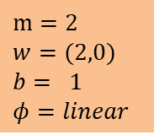
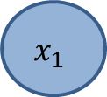
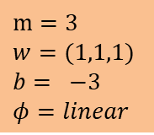
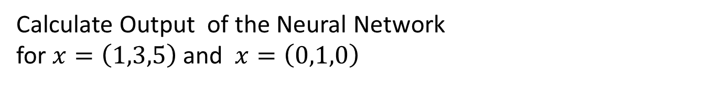
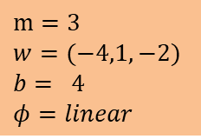
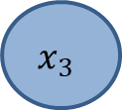

Calculate Output of the Neural Network for $x=\left(1,3,5\right)$and $x=\left(0,1,0\right)$
$$m=3$$
$$w=(−4,1,−2)$$
$$b= 4$$
$$φ=linear$$
$$x_{1}$$
$$m=2$$
$$w=(2,0)$$
$$b= 1$$
$$φ=linear$$
$$x_{2}$$
$$x_{3}$$
$$m=3$$
$$w=(1,1,1)$$
$$b= −3$$
$$φ=linear$$
Lösungen: 27,11

